Slide 1
Project Name:
CAR PRICE PREDICTION

Slide 2
Problem Definition
With the covid 19 impact in the market, we have seen lot of changes in the car market. Now some cars are in demand hence making them costly and some are not in demand hence cheaper. One of our clients works with small traders, who sell used cars. With the change in market due to covid 19 impact, our client is facing problems with their previous car price valuation machine learning models. So, they are looking for new machine learning models from new data. We have to make car price valuation model.

Slide 3
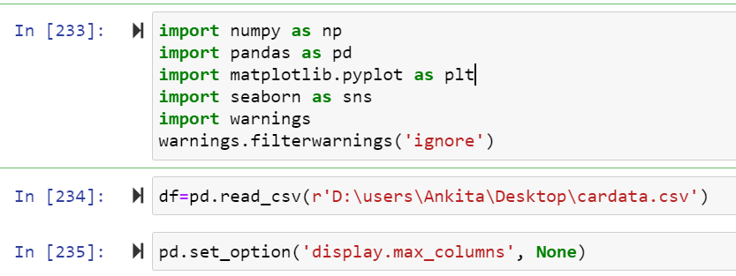
Dataset:
Here there are car dataset was present import the library and load the dataset.

Slide 4
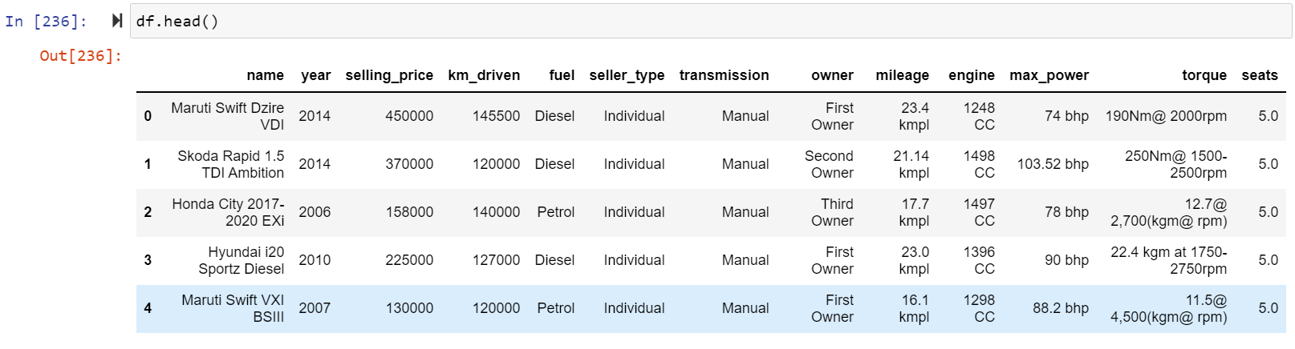
Display Dataset:
Herein this car dataset 5000 rows and 13 columns was present.

Slide 5

Data Analysis:
Check the how much Columns and rows present in dataset using df.shape() is use to check the rows and columns count in this below dataset there are 5000 rows and 13 columns are present in car dataset

Slide 6
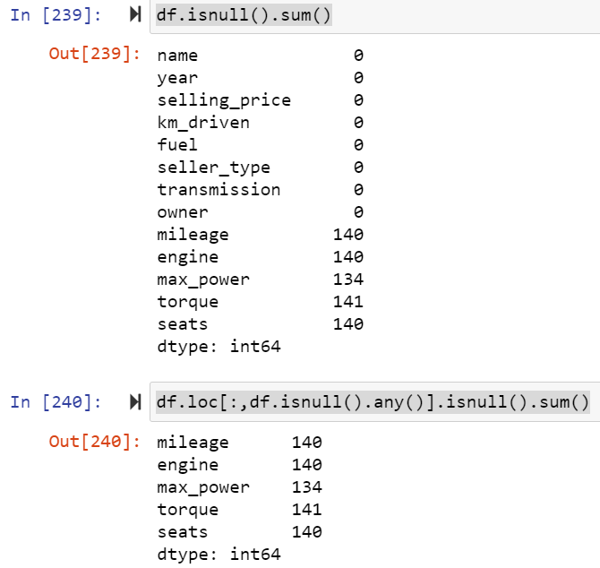
Check how much null values are present in dataset:
Here above dataset many columns null values are present.

Slide 7
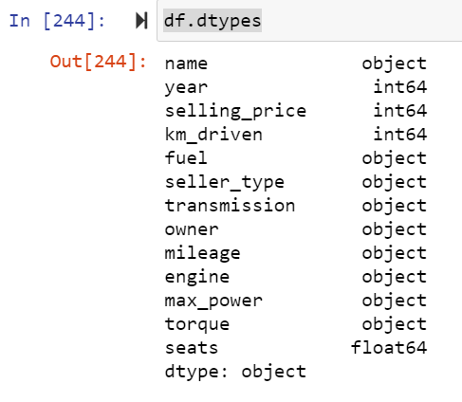
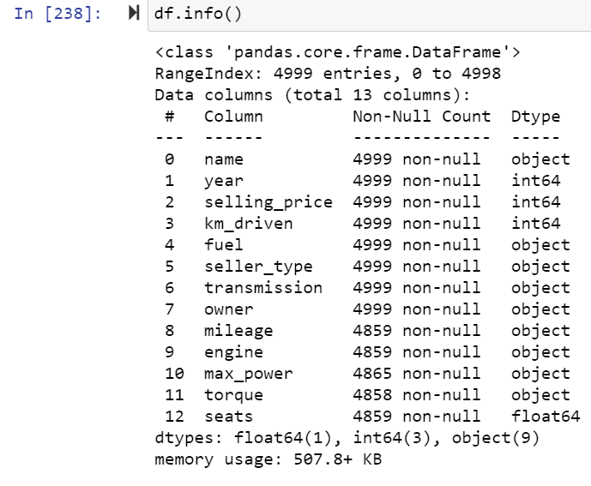
In below code df.dtypes is used to check the data types of all the column in dataset:
Above dataset categorical and numerical values are present.

Slide 8
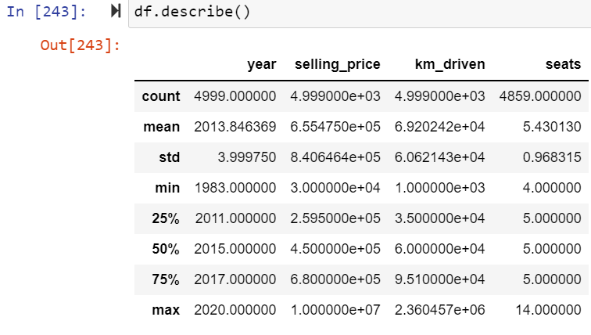
Describe the information of car dataset using df.describe() :

Slide 9
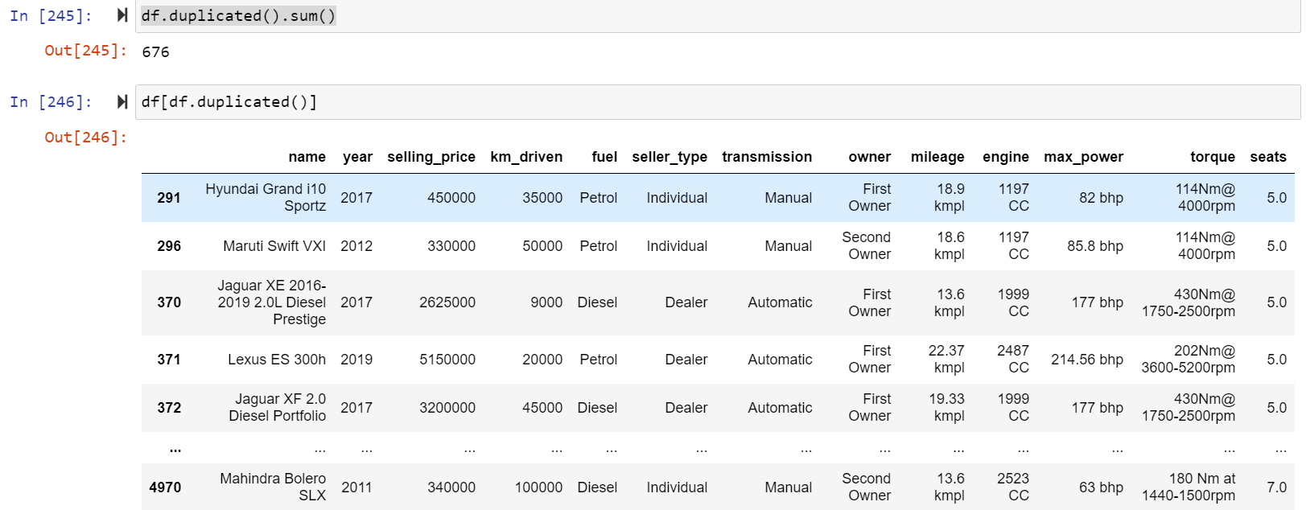
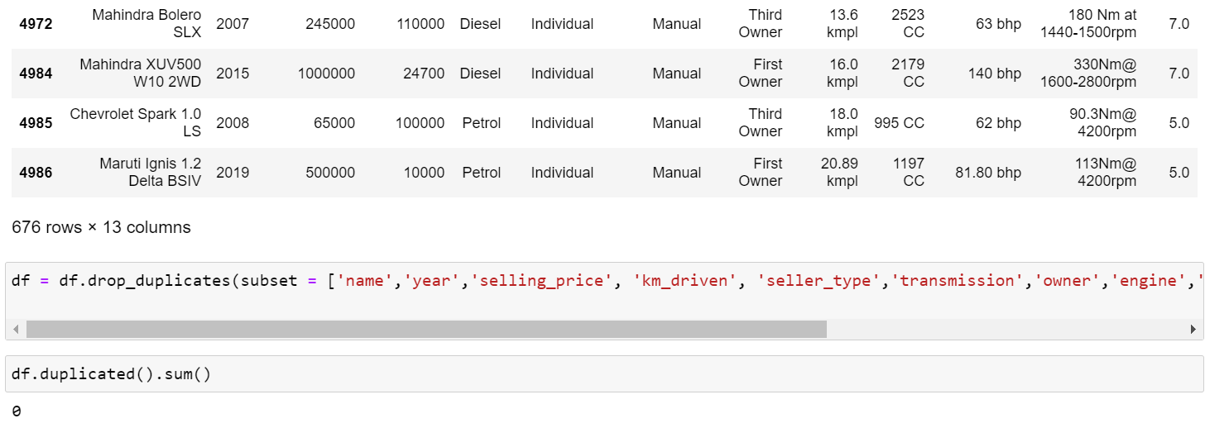
Check the duplicates values of car dataset :
There was no of duplicates values are present in dataset so drop that duplicate values from dataset

Slide 10
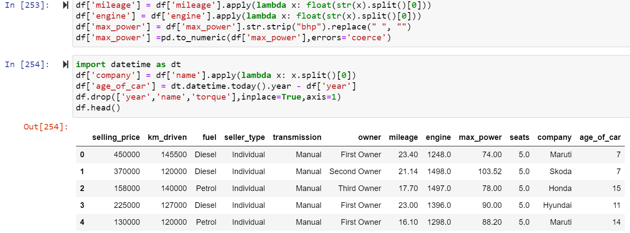
Splits values In dataset:
Here above ‘milenge’, ‘engine’, ‘max_power’ columns are categorical and numerical values are present so split that values and convert it into the numeric and also drop year,name and torque column beause it is not much important.

Slide 11
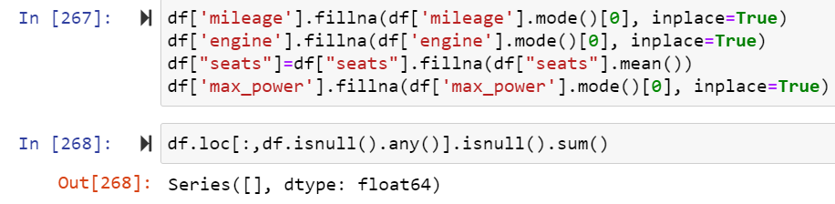
Data Preprocessing Done :
Fill all null values in milenge, engine, seats and max_power columns in car dataset.

Slide 12
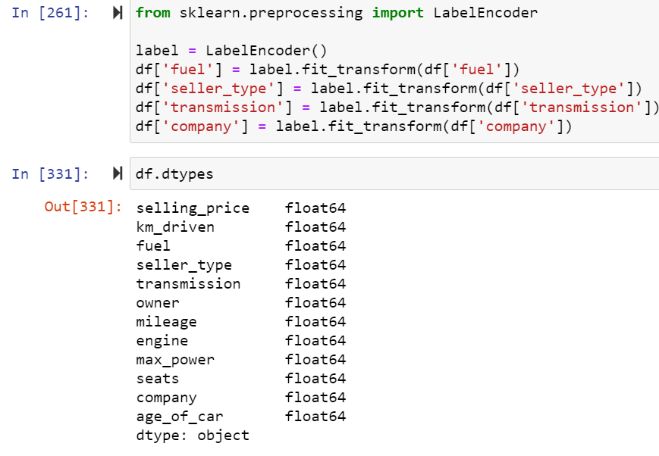
Encoding:
Here we converted categorical data into numeric in car dataset because without converting categorical data into numeric we cannot find out correlation of the dataset

Slide 13
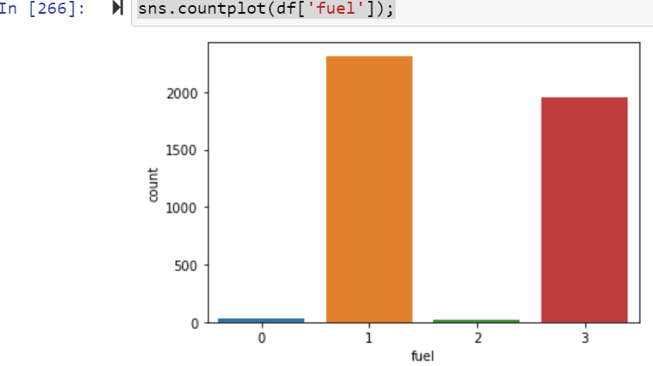
EDA:
Univarient Analysis of car dataset:
Univarient analysis of ‘fuel’ column in train dataset

Slide 14
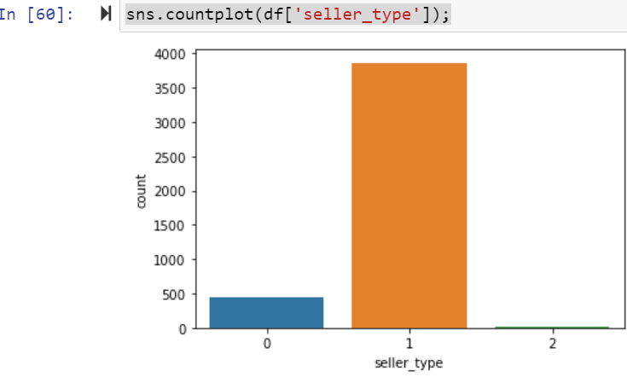
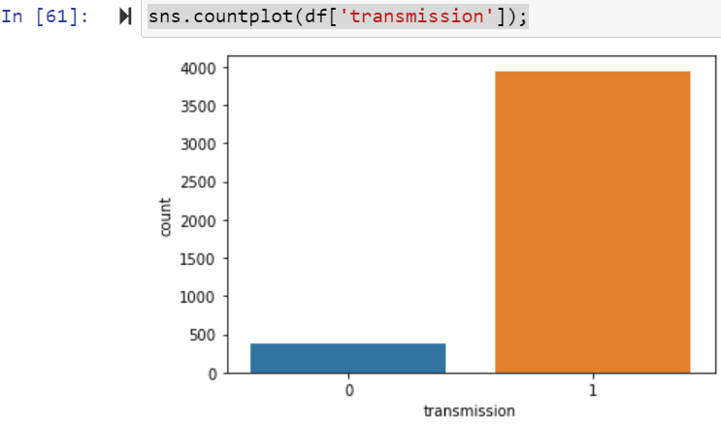
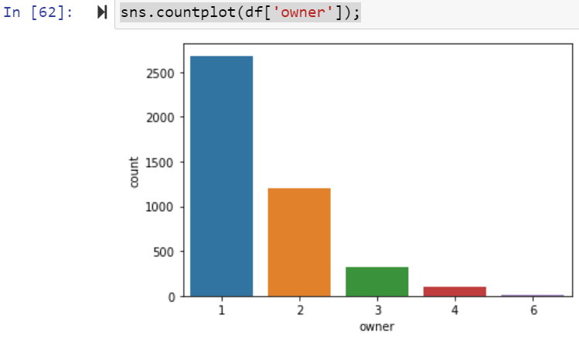
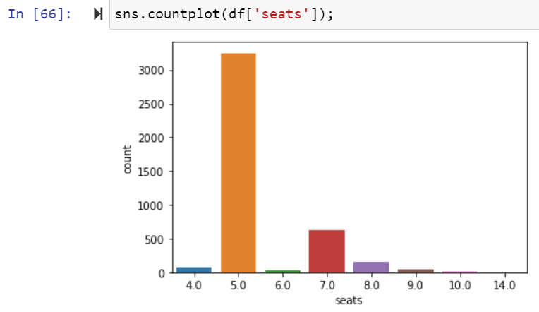
Univarient Analysis of all columns in dataset.

Slide 15
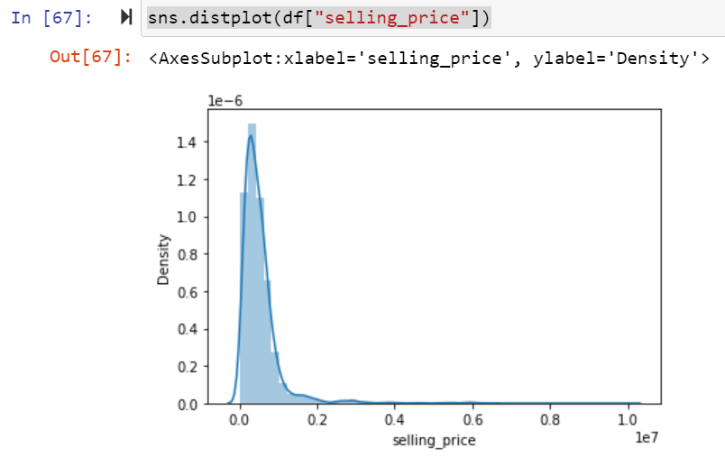
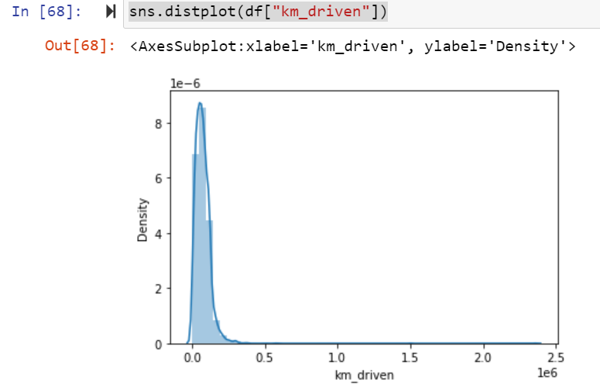
Checking Distribution of all columns in car dataset:

Slide 16
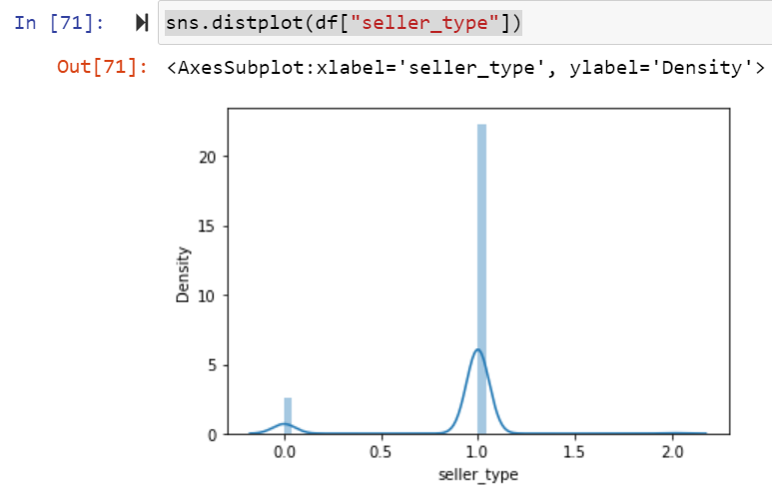

Slide 17
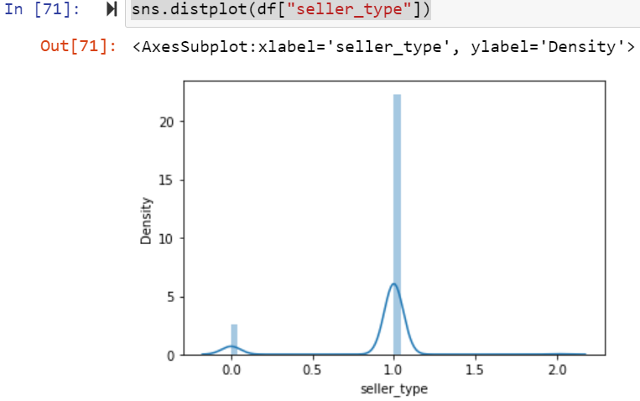
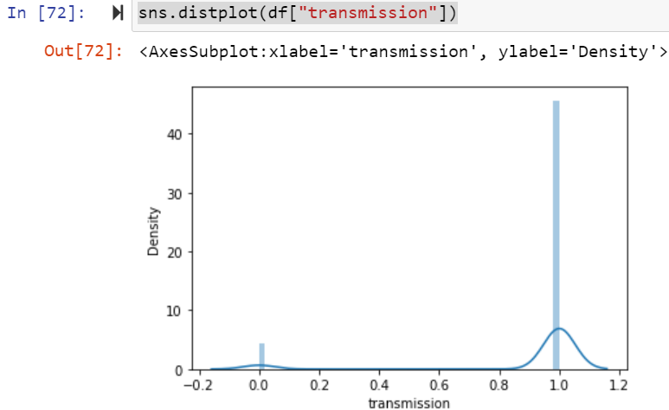
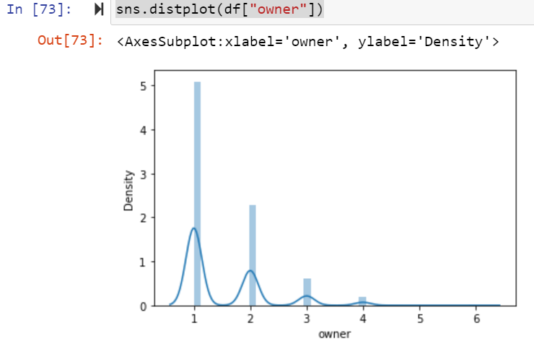
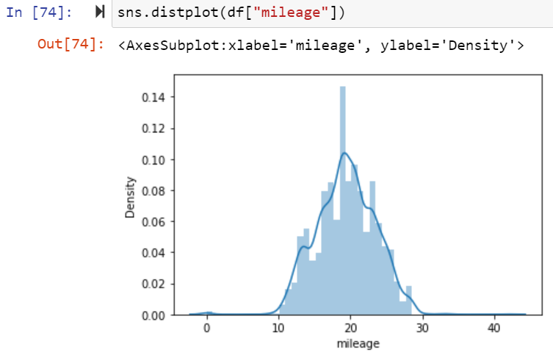

Slide 18
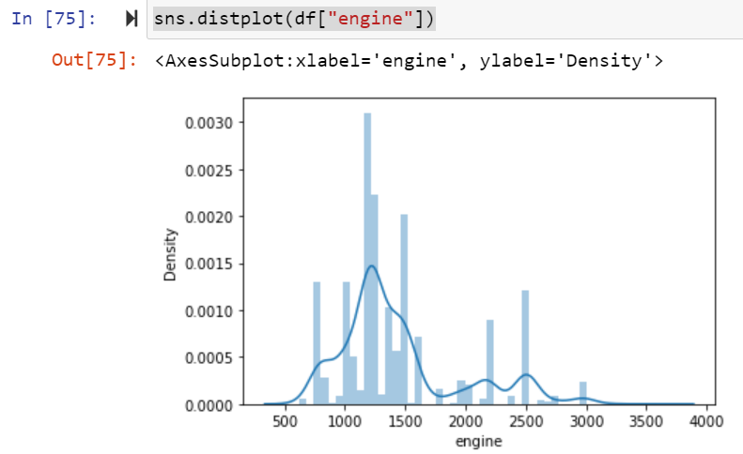
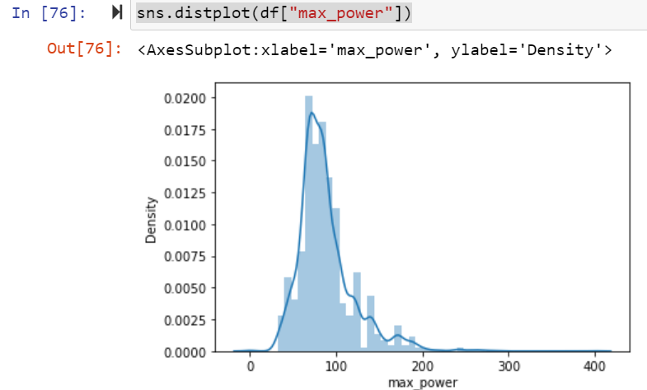
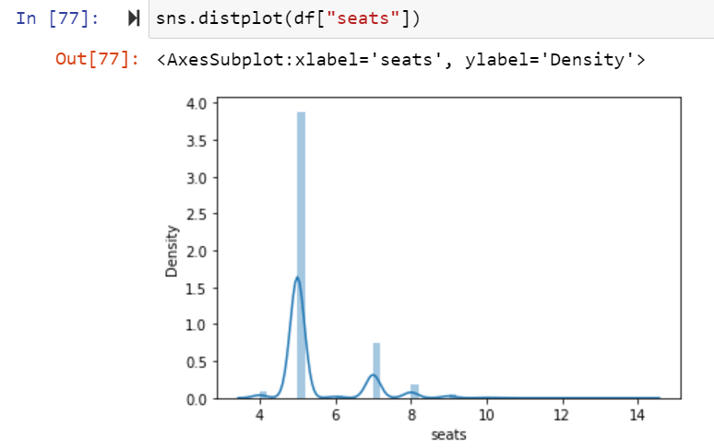
Here some columns are normally distributed and some columns are not normally distributed.

Slide 19
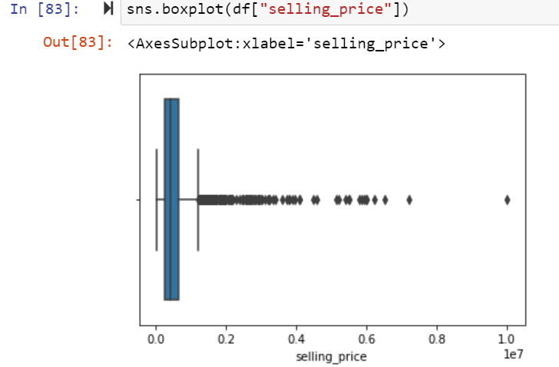
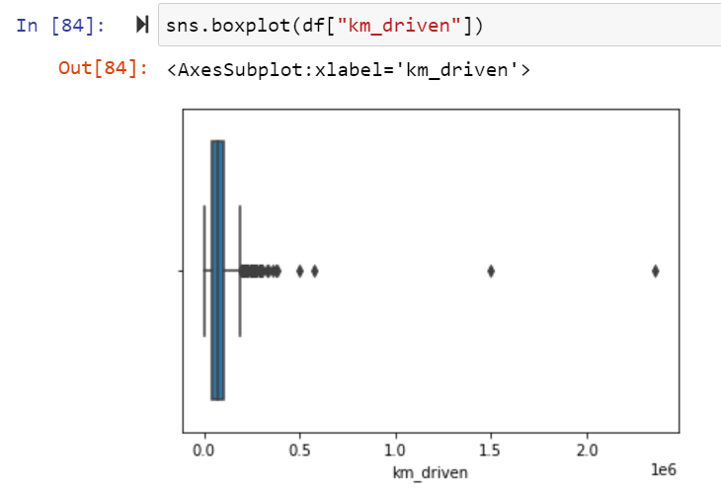
Checking Outliers:

Slide 20
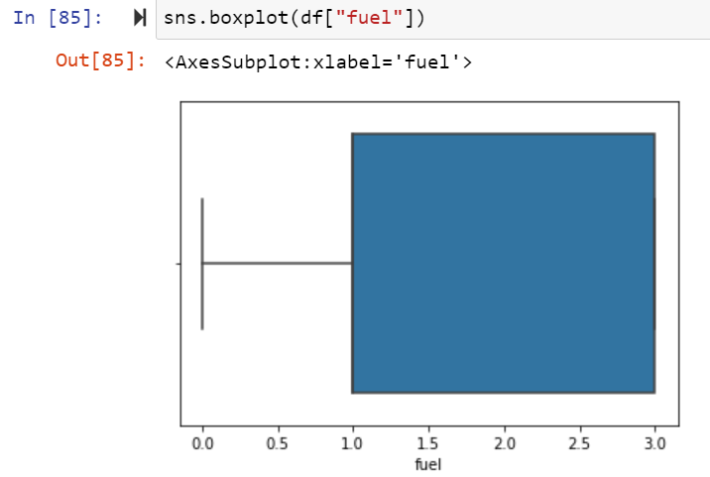
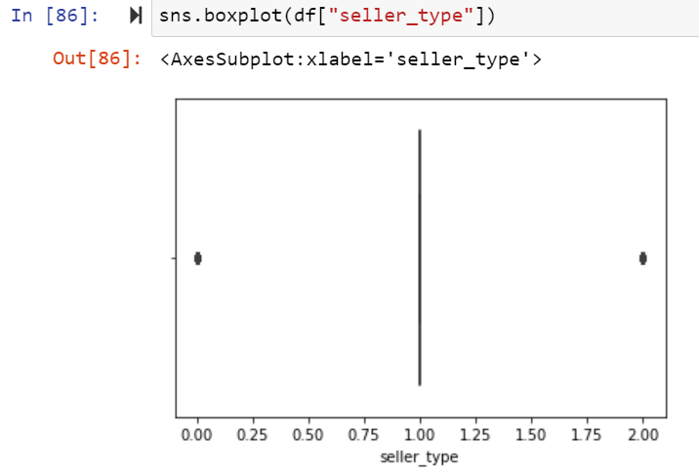
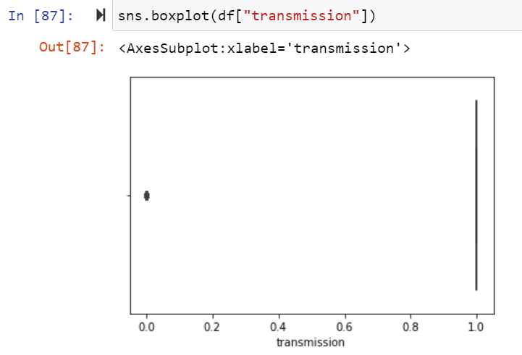
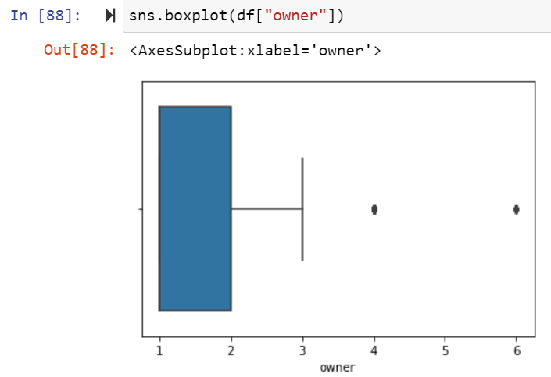

Slide 21
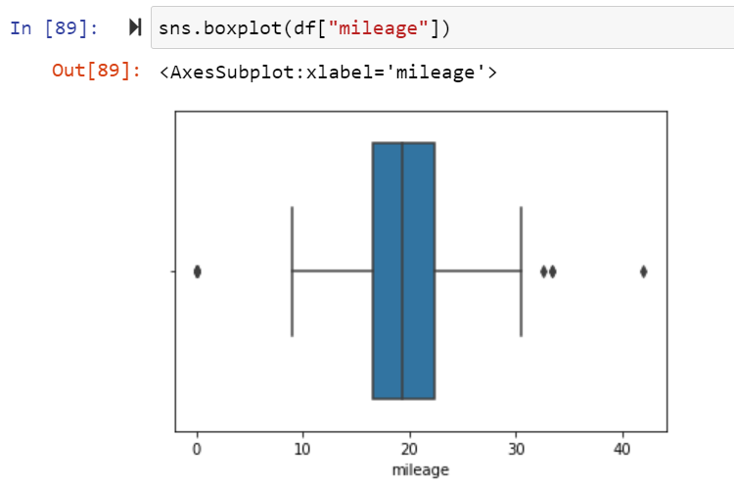
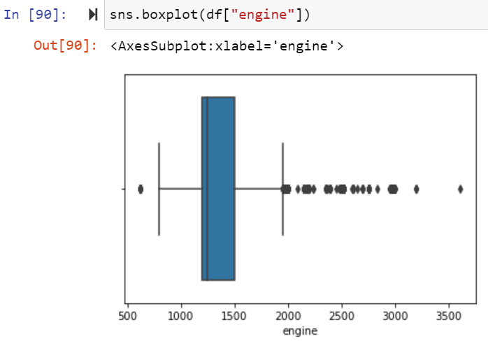
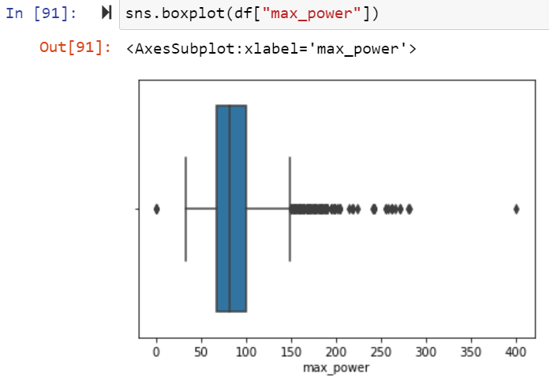
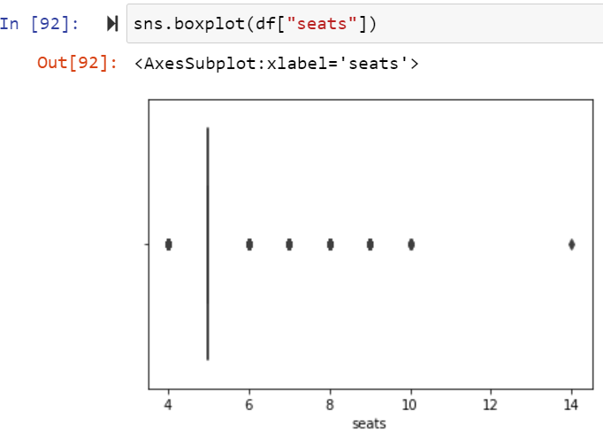
Here only ‘fuel’ column outlier is not present but all the remaining columns outliers was present.

Slide 22
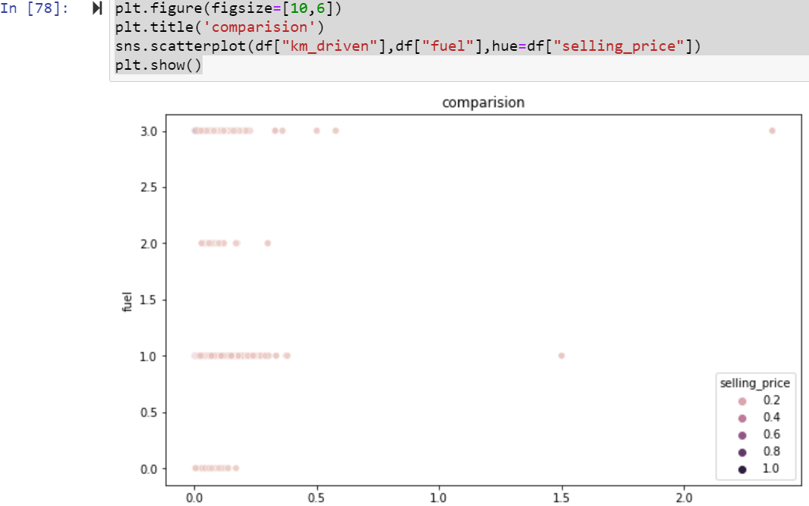
Bi varient Analysis Car dataset:
Scatter Plot of Car Dataset:

Slide 23
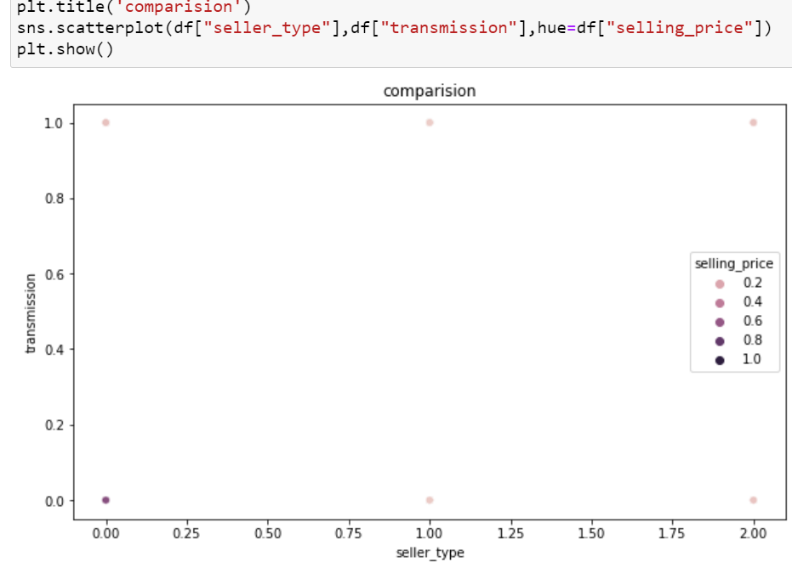
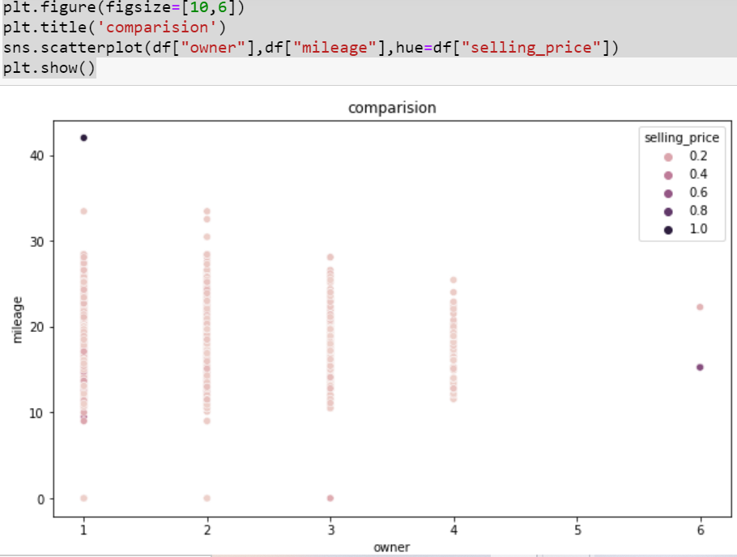

Slide 24
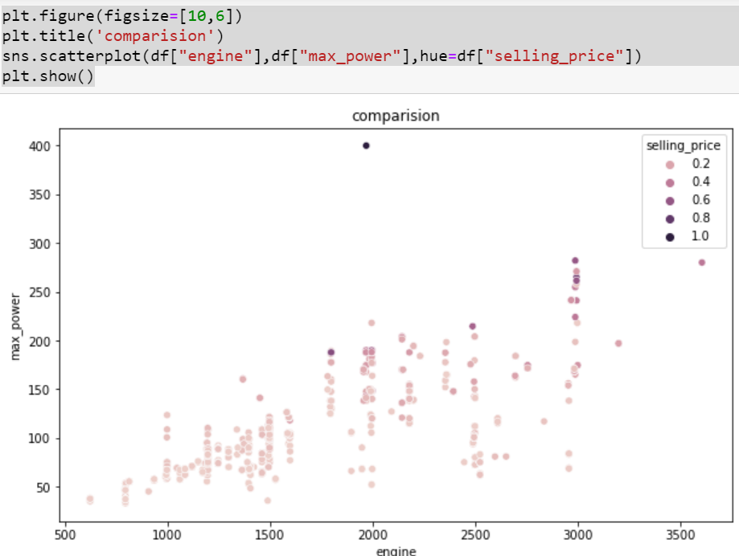
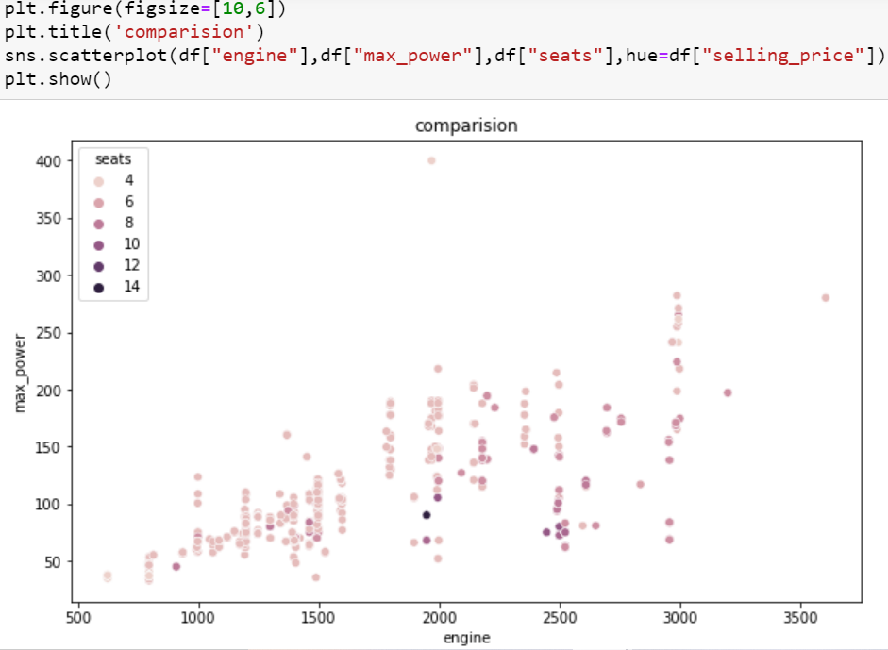

Slide 25
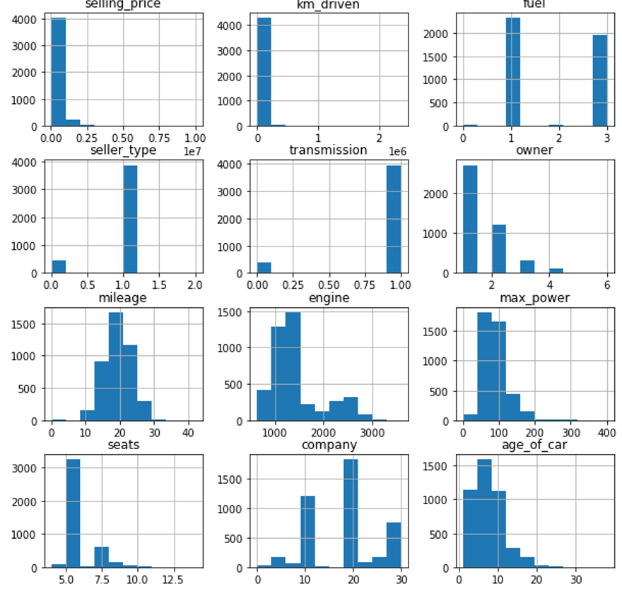
Histplot Train Dataset:
Histplot of Bar plot of all the columns.

Slide 26
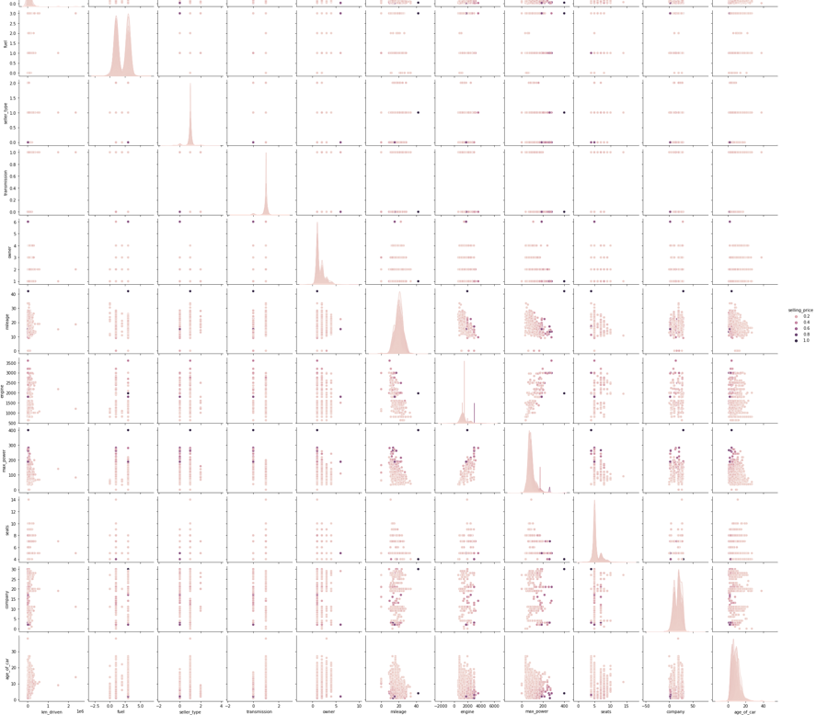
Multi Varient Analysis of Car Dataset:

Slide 27
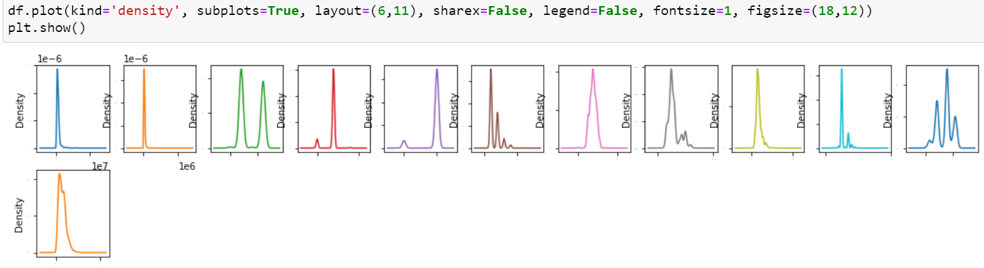
pair plot of all the columns

Slide 28
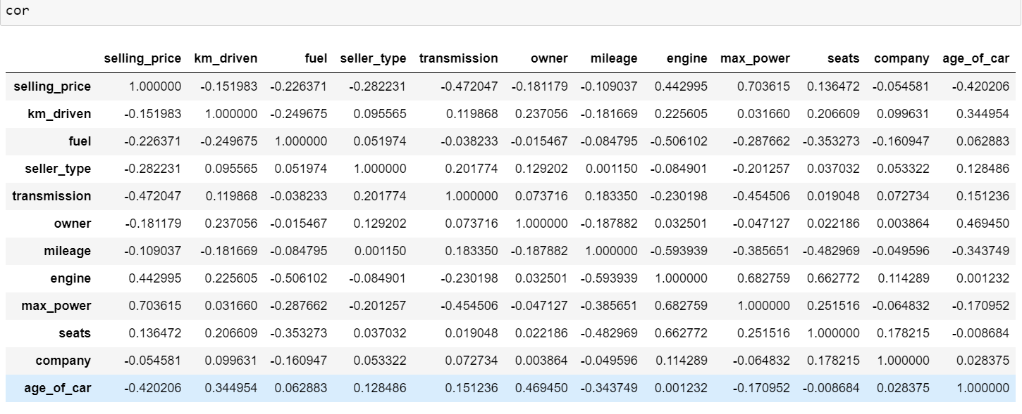
Visualizations:
Correlation of Car dataset:
After that Checking Correlation of all independent columns with Target column.

Slide 29
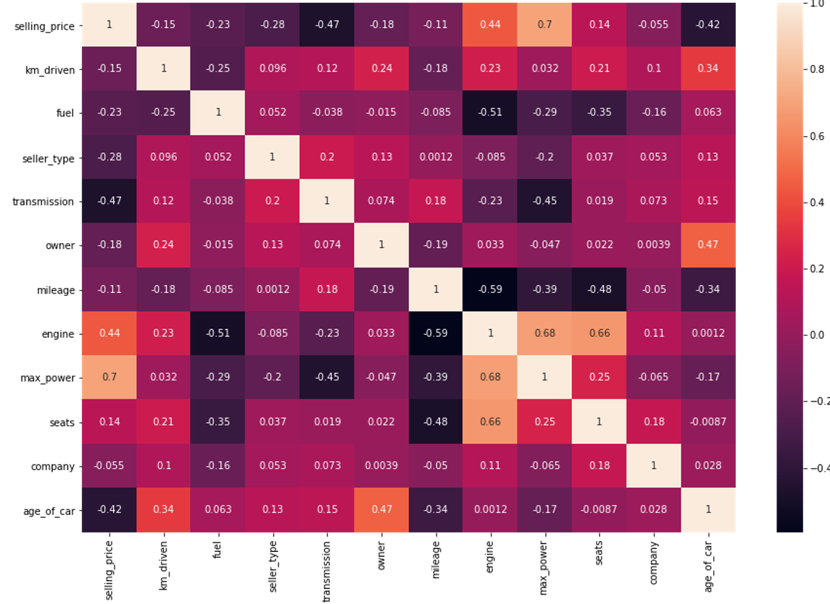
Heatmap of Car dataset:
Heat map shows the correlation of every independent variable in dataset with target variable. Here above heatmap the every independent variable check correlation with selling_price target variable.

Slide 30
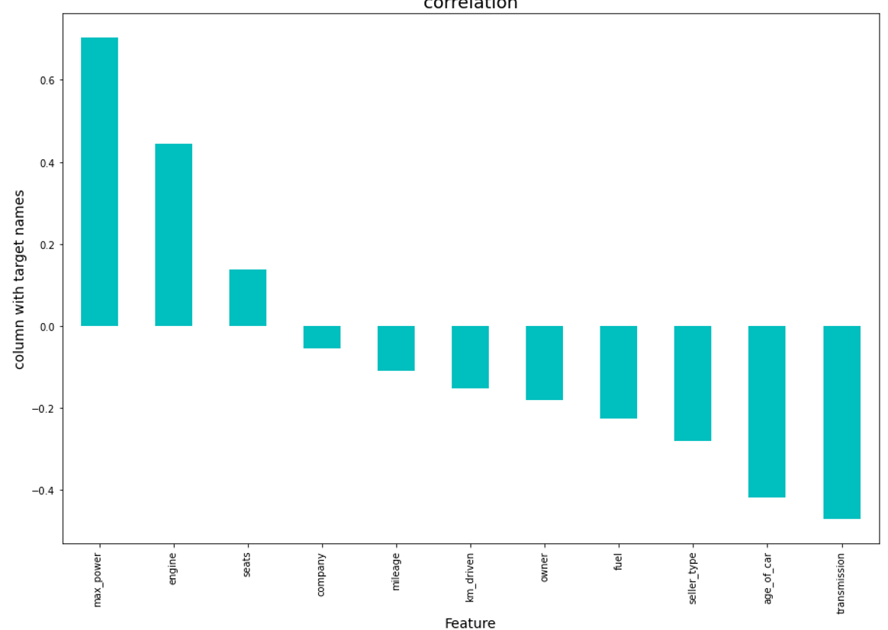
Shows Correlation is another way:
Here we shows the correlation in another way in this above we show some columns are positively and some columns are negatively correlated with target variable.

Slide 31
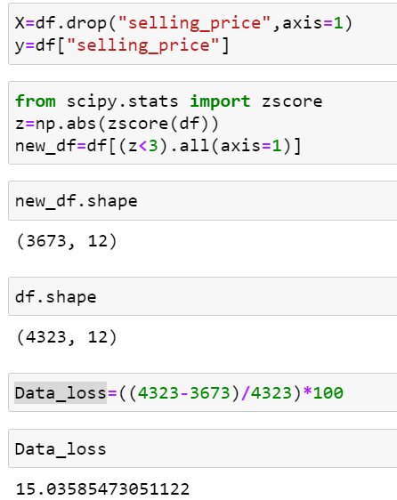
Use Z-score for check dataloss:
Here 15 persent dataloss using zscore

Slide 32
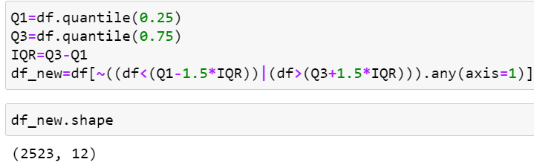
Use IQR for check dataloss:
Here After Applying IQR method checking dataloss here using IQR method more dataloss.

Slide 33
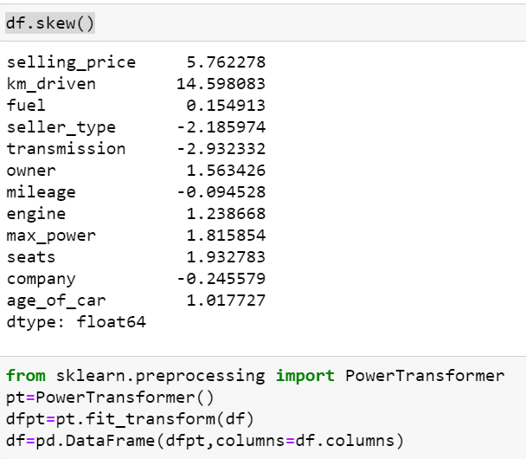
Checking Skewness:

Slide 34


To remove skewness use PowerTransformer and log transformer technique in dataset.

Slide 35

Min Max scaler Technique:
We can apply the MinMaxScaler to the dataset directly to normalize the input variables.
We will use the default configuration and scale values to the range 0 and 1. First, a MinMaxScaler instance is defined with default hyperparameters. Once defined, we can call the fit_transform() function and pass it to our dataset to create a transformed version of our dataset.

Slide 36

Building Machine learning Models:

Slide 37

Lasso Regression:
Here r2 score is 0.61 for dataset and cross validation score is 0.58 in Lasso algorithm.

Slide 38

Ridge Regression:
Here r2 score is 0.61 for dataset and cross validation score is 0.59 in Ridge algorithm.

Slide 39

RandomForest Regression:
Here r2 score is 0.89 for dataset and cross validation score is 0.89 in RandomForestRegressor algorithm.

Slide 40

SVR Regression:
Here r2 score is -0.044 for dataset and cross validation score is 85 in SVR algorithm.

Slide 41

AdaBoostRegressor:
Here r2 score is 0.46 for dataset and cross validation score is 77 in AdaBoostRegressor algorithm.

Slide 42

DecisionTreeRegressor:
Here r2 score is 0.80 for dataset and cross validation score is 77 in DecisionTreeRegressor algorithm.

Slide 43

KNN Regressor:
Here r2 score is 0.66 for dataset and cross validation score is 77 in KNN algorithm.

Slide 44

GridSearchCv:
Here above are the parameter list of RandomForestRegressor model.
The above code block we have the following parameters max_features: In this maximum features there are two values auto and auto,sqrt.
Criterion: In criterion have mse and mae are two parameters.

Slide 45


Here after use different parameter list the best parameter list is select.
Above are the best parameter list RandomForestRegressor. Put this parameters into the model so output is finally best score is RandomForestRegressor is 85 so it is the best score.

Slide 46

Finally Load the model and predict the values:

Slide 47

Finally Load the model and predict the values.

Slide 48
Conclusion:
The increased prices of new cars and the financial incapability of the customers to buy them, Used Car sales are on a global increase. Therefore, there is an urgent need for a Used Car Price Prediction system which effectively determines the worthiness of the car using a variety of features. The proposed system will help to determine the accurate price of used car price prediction. This paper compare different algorithms for machine learning : Linear Regression, Lasso Regression and Ridge Regression, SVR, Random Forest Regressor, KNN, DecisionTree Regressor

Slide 49
Limitations of this work and Scope for Future Work
In future this machine learning model may bind with various website which can provide real time data for price prediction. Also we may add large historical data of car price which can help to improve accuracy of the machine learning model. We can build an android app as user interface for interacting with user. For better performance, we plan to judiciously design deep learning network structures, use adaptive learning rates and train on clusters of data rather than the whole dataset.
For better performance, we plan to judiciously design deep learning network structures, use adaptive learning rates and train on clusters of data rather than the whole dataset. To correct for overfitting in Random Forest, different selections of features and number of trees will be tested to check for change in performance.

